Slide 1
ViewEdo
PROJECT PRESENTATION

Slide 2
ABSTRACT
Viewedo is a minimalistic web platform that caters to the needs of photo editing enthusiasts. With a focus on simplicity and functionality, Viewedo offers a range of features designed to enhance users' photo editing skills. The platform provides free tutorials and small vlogs that cover various aspects of photo editing, allowing users to learn new techniques and tips. In addition, Viewedo offers comprehensive resources to help users understand the basics of photo editing and explore leading software tools in the industry. For those seeking more advanced knowledge, premium tutorials are available for purchase. Viewedo strives to create a user-friendly environment where individuals can acquire valuable skills and elevate their photo editing capabilities.

Slide 3
REQUIREMENTS
User Registration And Login Functionalities
Admin Dashboard
Different Types Of Tutorials For Different Editing Software’s
Tutorial videos and step by step document’
User Vlog
Comment on Tutorials
Payed Tutorials

Slide 4
FEATURES AND HIGHLIGHTS
Login and registration: The user will be able to register themselves using Django users. The user will be redirected to the user home page after logging in
No Login Required: Users can view the free tutorials without the need to create an account or log in. This allows for quick and easy access to the learning material.

Slide 5
FEATURES AND HIGHLIGHTS
Vlogs: Users have the option to add small vlogs (video blogs) where they can share their own photo editing tips and experiences. They can also explore vlogs created by other users, providing a platform for knowledge sharing and community engagement.
My Courses: Each user has the ability to create their own curated collection of tutorials by adding them to their personal "My Courses" section. This feature enables users to easily access and revisit their preferred tutorials.

Slide 6
FEATURES AND HIGHLIGHTS
Comments and Feedback: Users can actively participate in the learning community by leaving comments and feedback on individual tutorials or courses. This fosters interaction, collaboration, and the sharing of ideas among users.
Premium Tutorials: In addition to the free content, Viewedo offers premium paid tutorials. These tutorials provide advanced techniques, in-depth knowledge, and exclusive content for users who are looking to further enhance their photo editing skills.

Slide 7
THIRD-PARTY LIBRARIES
Third-party applications and libraries in Django are pre-built components or packages developed by the community or other companies that you can use to extend the functionality of your Django projects.
Django Jazzmin: a drop-in app to jazz up your Django admin site, with plenty of things you can easily customize, including a built-in UI customizer.

Slide 8
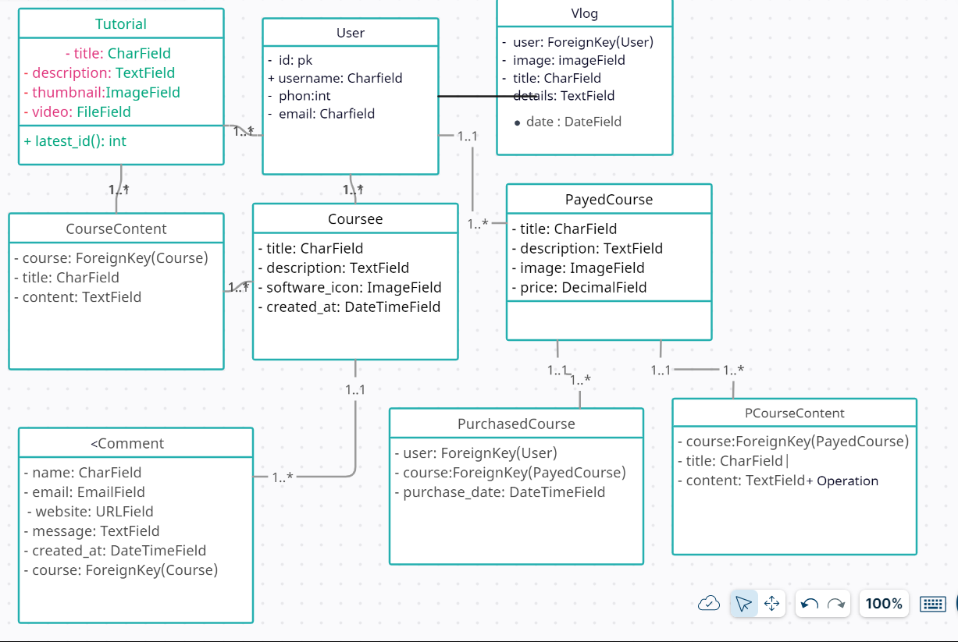
CLASS DIAGRAM
Notes:
Consider talking about:
Selection
Layers
Image size alteration
Cropping an image
Cutting out a part of an image from the background
Histogram
Noise reduction
Removal of unwanted elements
Selective color change
Image orientation

Slide 9
CHALLENGES FACED
One of the challenges I faced during the creation of a user interface was the initial planning phase. Defining the overall structure, layout, and design elements required careful consideration and decision-making.
Another challenge was planning the flow of the project. Determining how users would navigate through different screens and functionalities, and ensuring a smooth and logical progression was a complex task

Slide 10
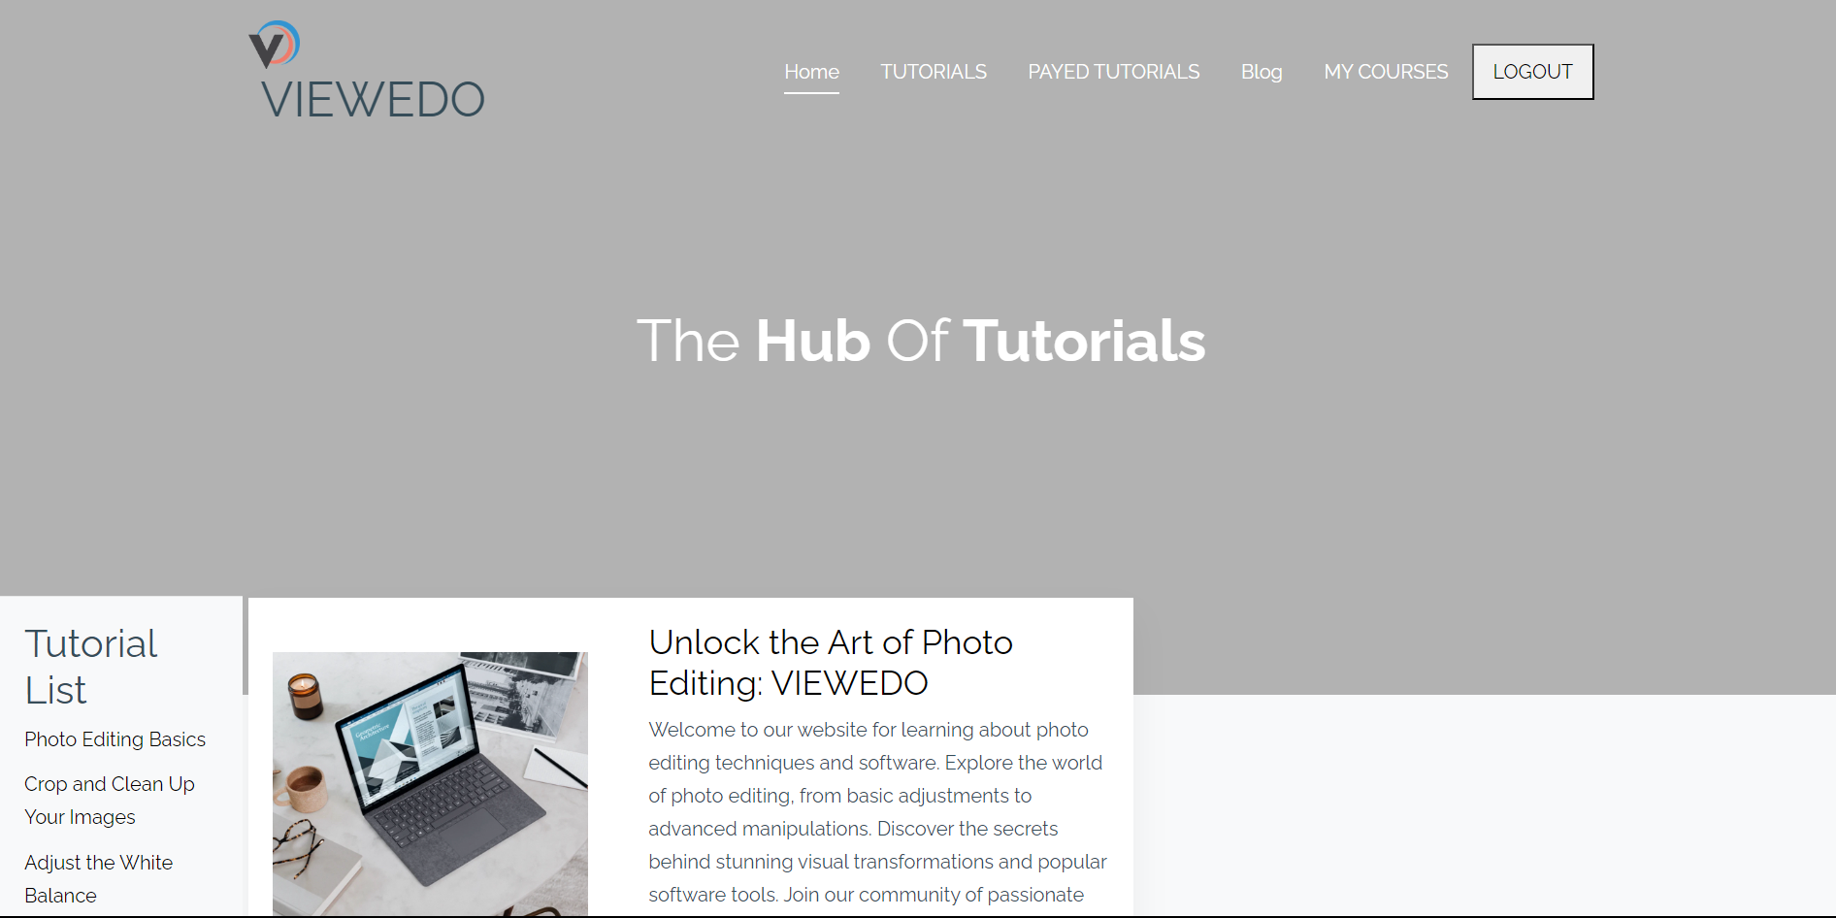
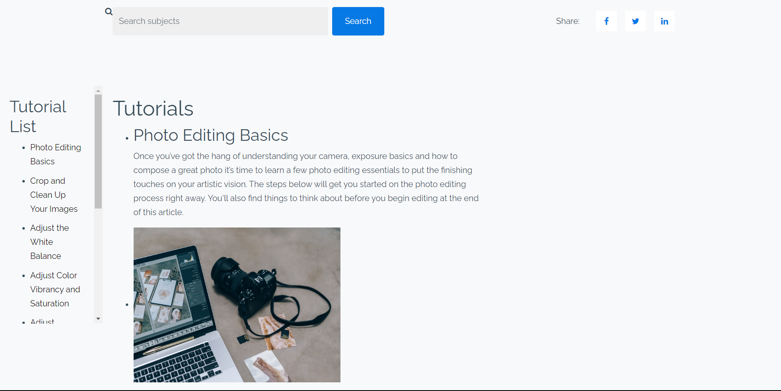
SCREENSHOTS
INDEXPAGE: indexpage provides navigation and common tutorials of photo editing and video tutorials

Slide 11
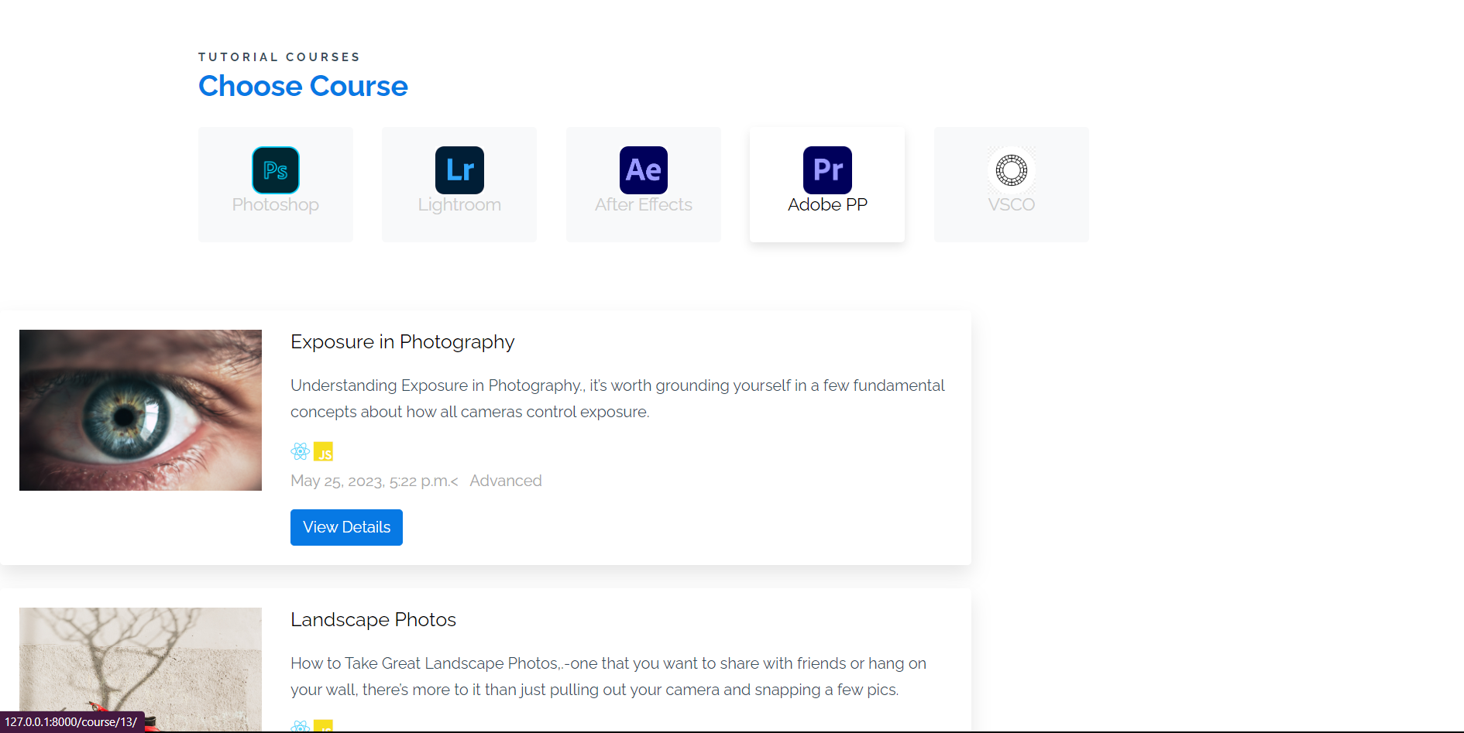
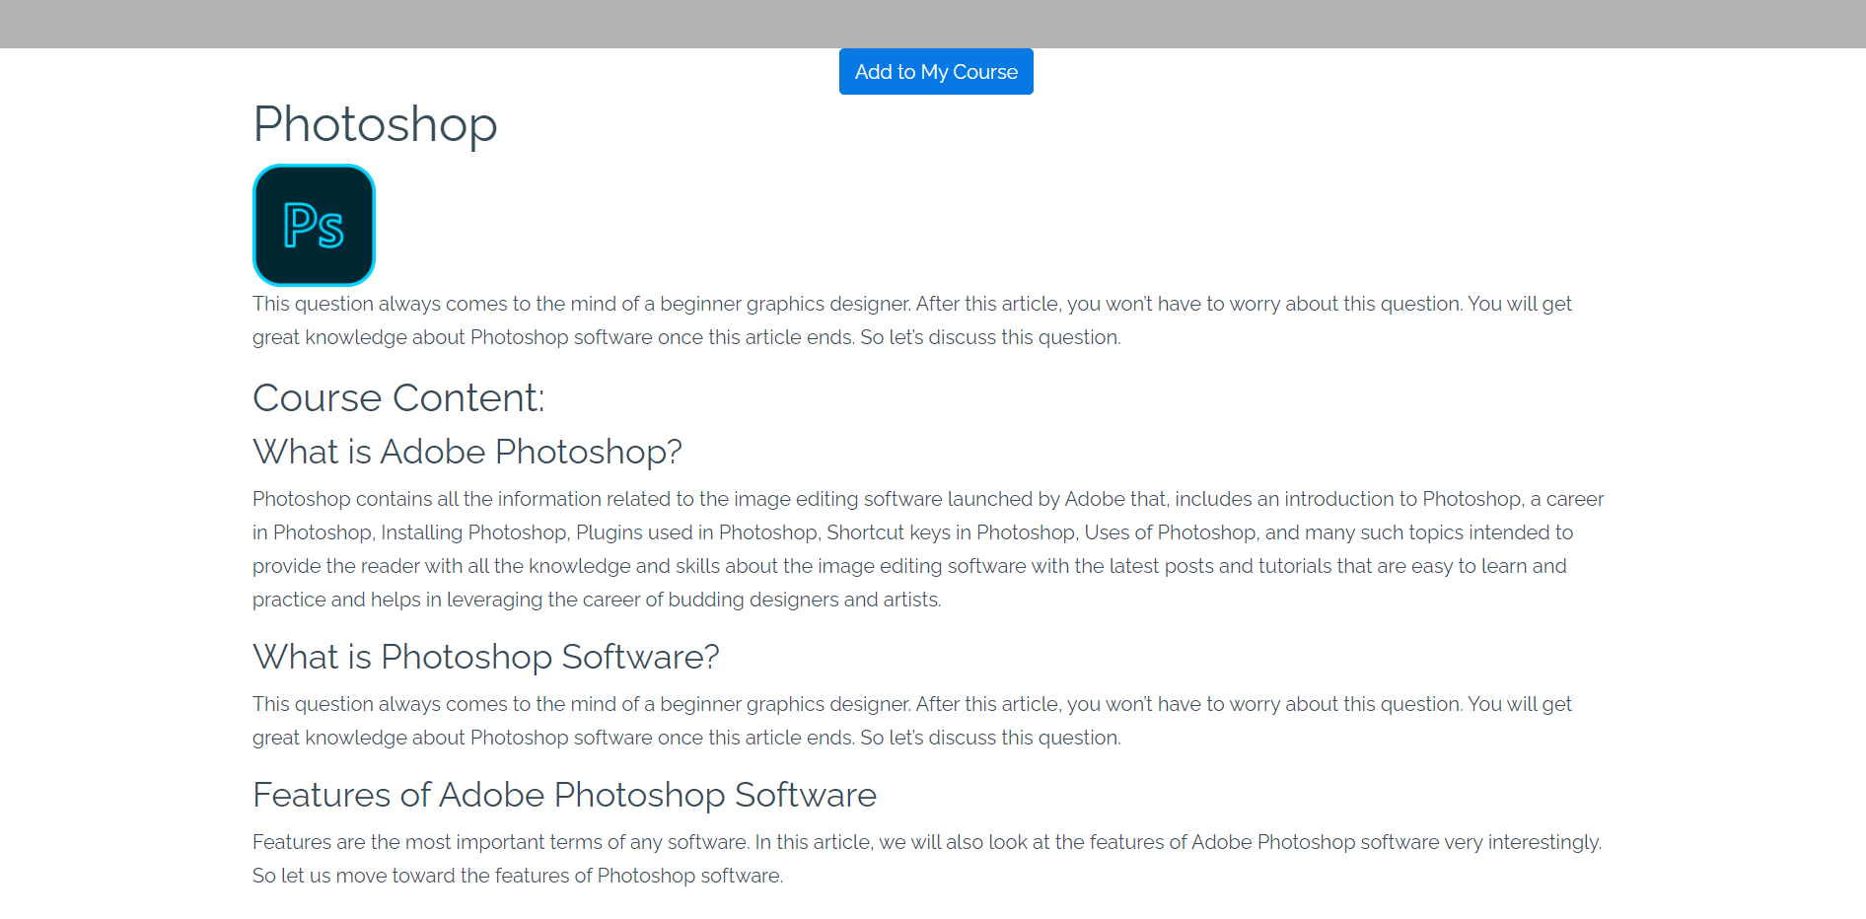
SCREENSHOTS
Free Tutorials : Free tutorials of famous softwares and contents which is free

Slide 12
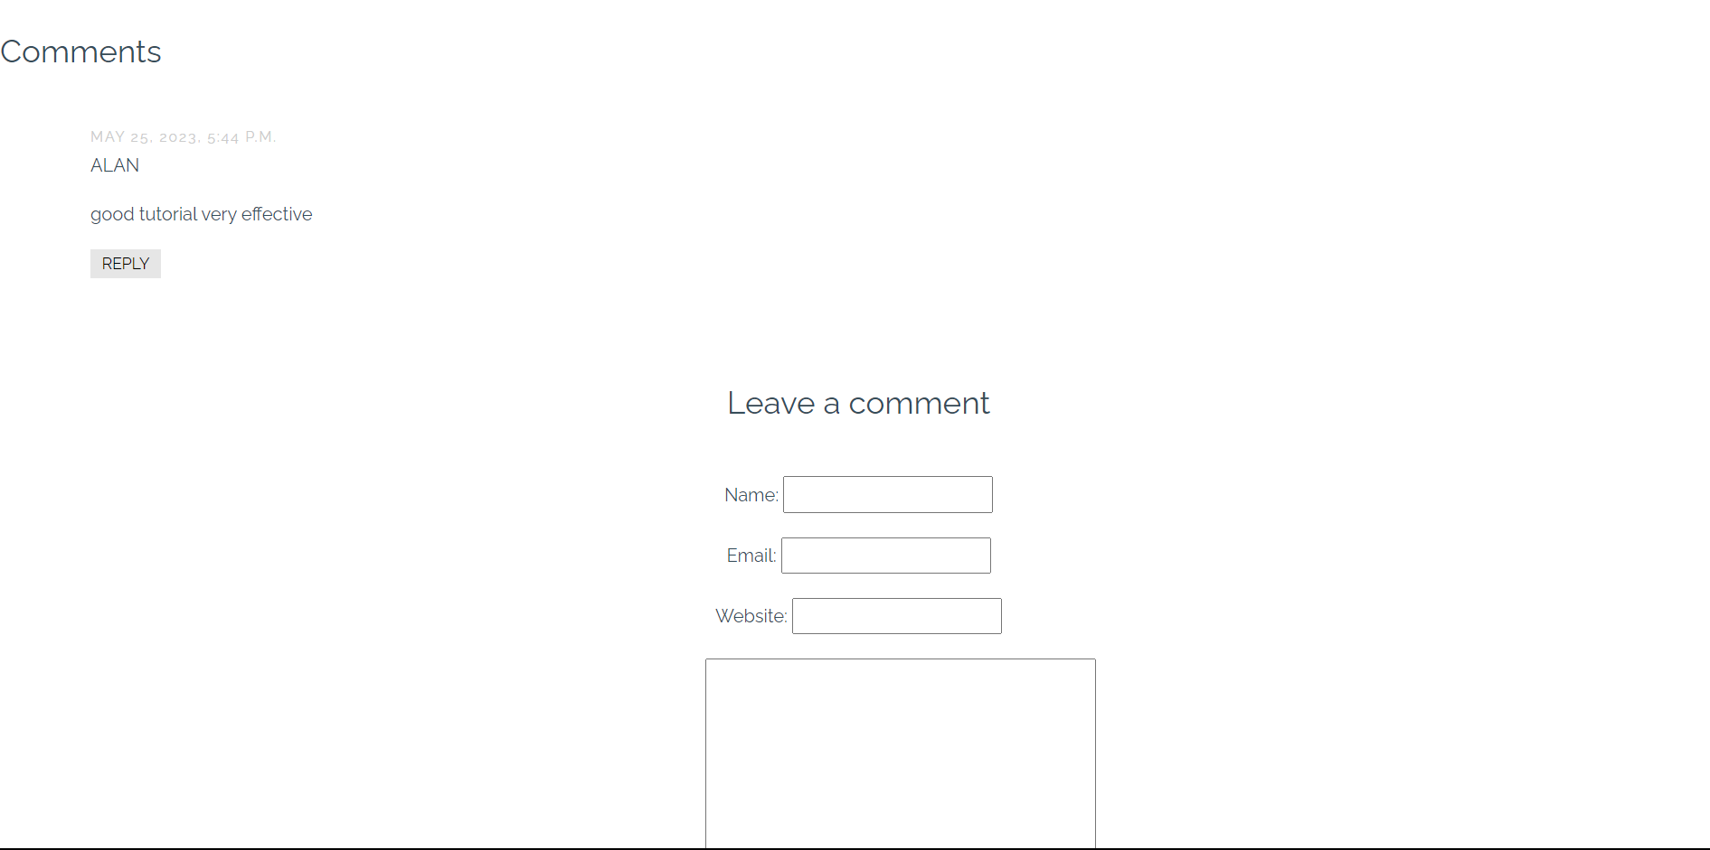
SCREENSHOTS
Comment Section under each course : users can ad comments under each course

Slide 13
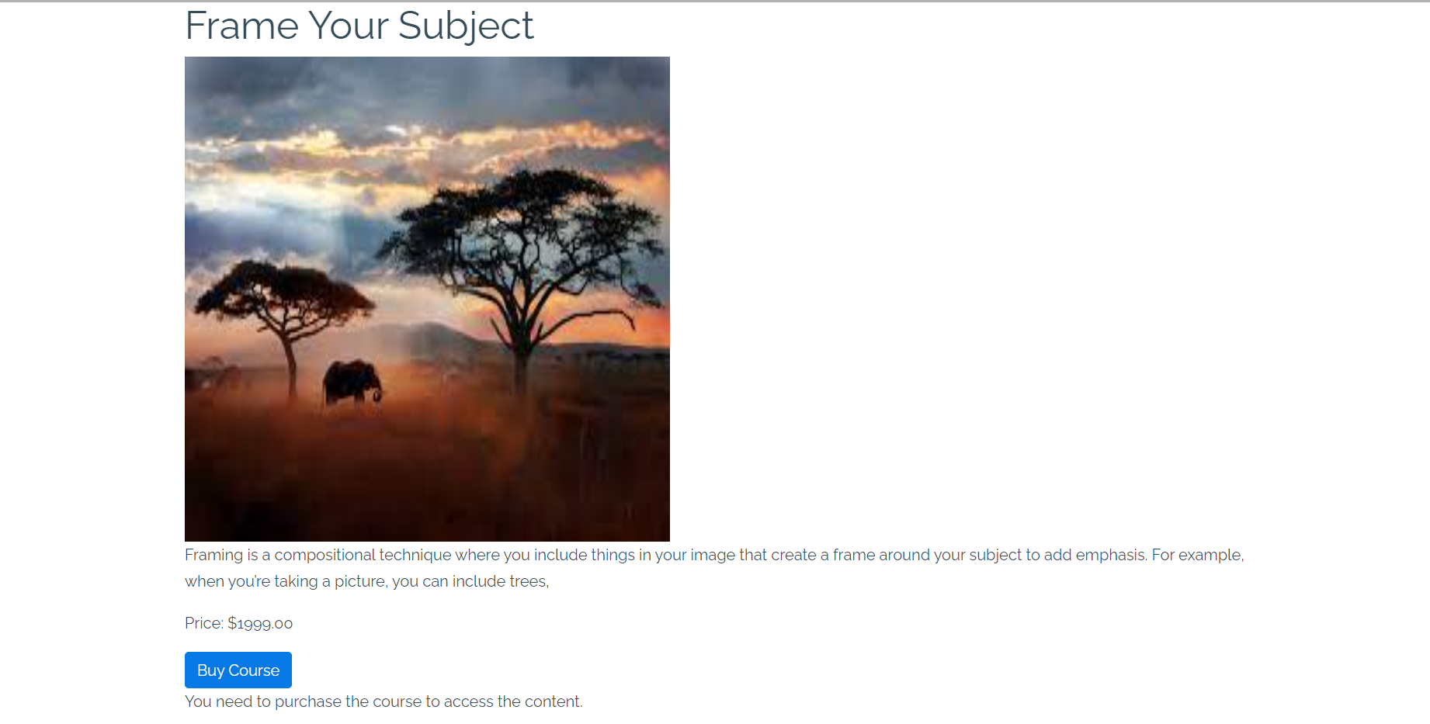
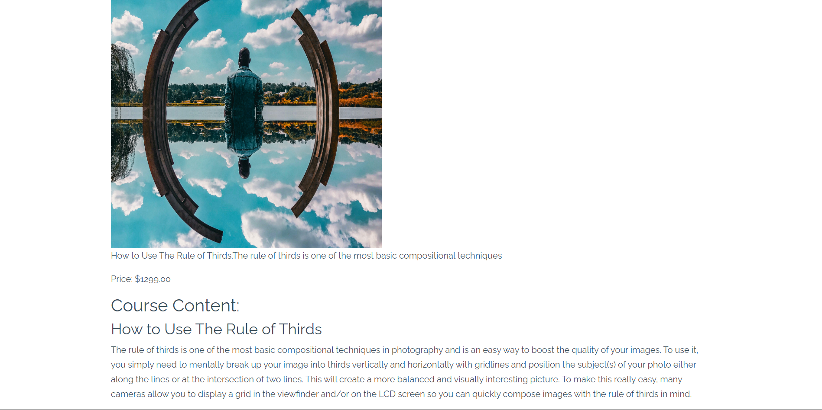
SCREENSHOTS
Payed Courses: Payed courses before and after payment

Slide 14
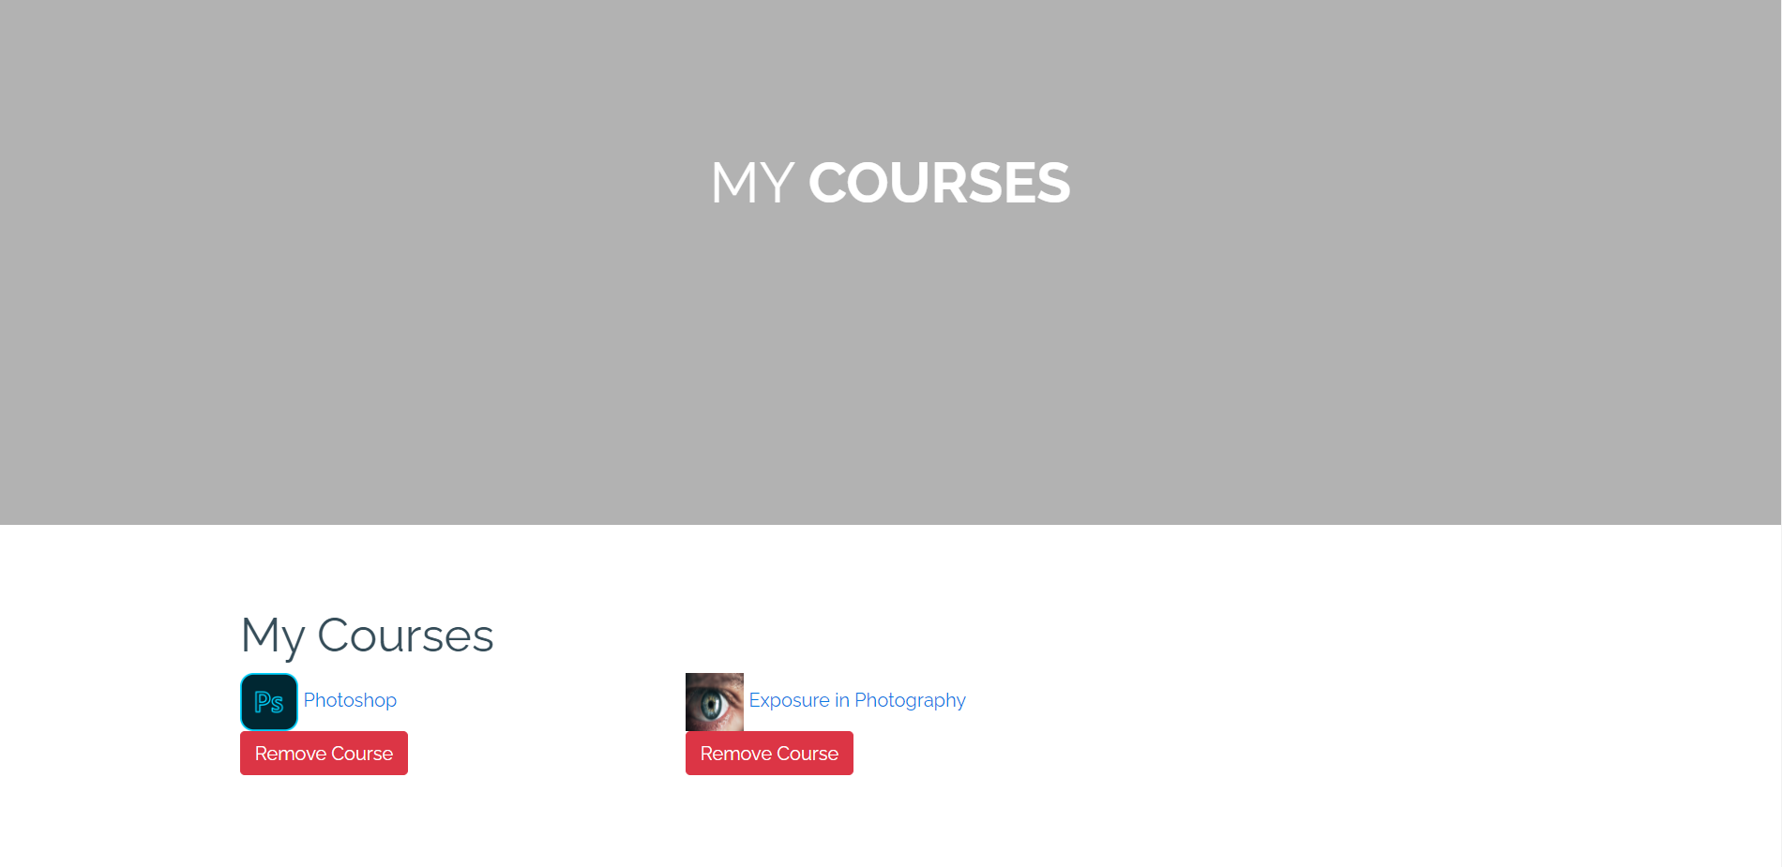
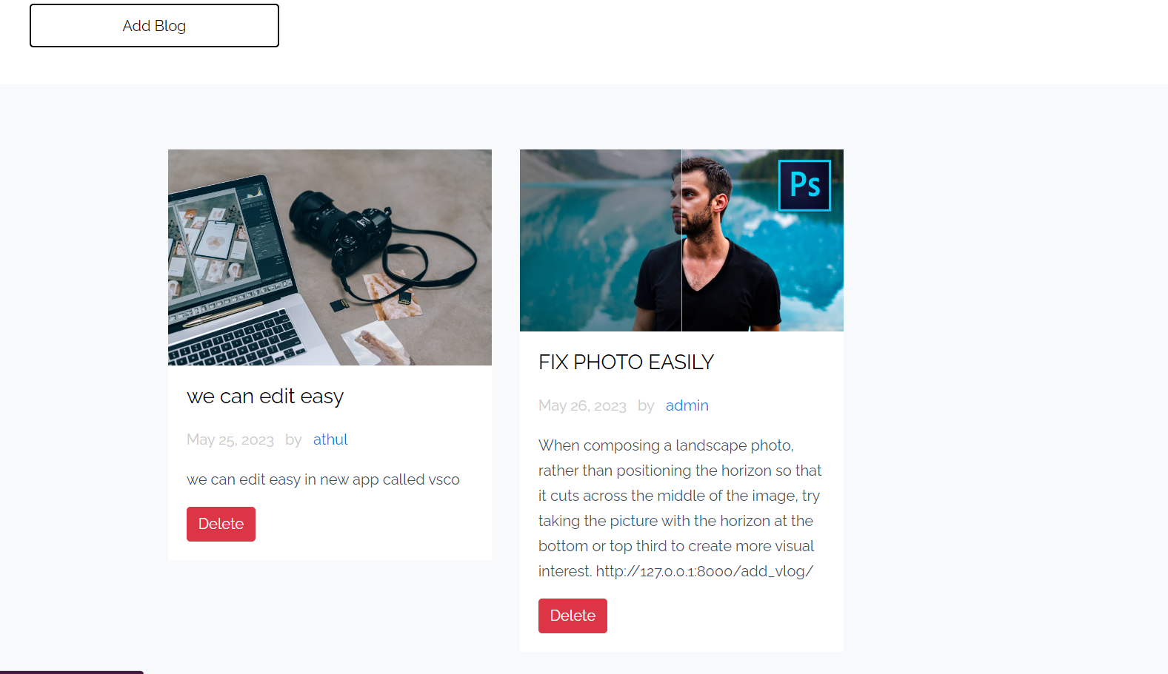
SCREENSHOTS
My Courses:My courses where users can add courses and
Blogs: Where users can add small blogs

